Slide 1

LIGHT SENSOR SWITCH CIRCUIT USING LDR AND 741 IC
BRACT’S
VISHWAKARMA INSTITUTE OF INFORMATION TECHNOLOGY
DEPARTMENT OF ENGINEERING AMD APPLIED SCIENCE
Academic year:2024
Semester : 2
Batch: B3
Sr.no. | Roll no. | PRN | Name
1. | 212053 | 22210241 | Shripad sangade
2. | 212058 | 22210414 | Omshree Teke
3. | 212067 | 22320022 | Chaitanya Mahamuni

Slide 2
INTRODUCTION
A light sensor switch circuit is a simple yet effective electronic circuit that automatically turns on or off a load (such as a lamp or LED) based on the ambient light level. This circuit finds applications in various areas, including outdoor lighting control, security systems, and energy-saving mechanisms.

Slide 3
COMPONENTS
LDR (Light Dependent Resistor): An LDR is a type of resistor whose resistance varies with the amount of light falling on it. It has high resistance in darkness and low resistance in brightness.
Operational Amplifier (Op-Amp) 741: The 741 IC is a widely used general-purpose operational amplifier in various analog applications. It can be configured in different modes, such as a comparator or amplifier, depending on the circuit requirements.
Resistors: A few resistors are required to set up the voltage divider and determine the threshold light level at which the switch operates.
Power Supply: A DC power supply is needed to power the circuit.

Slide 4
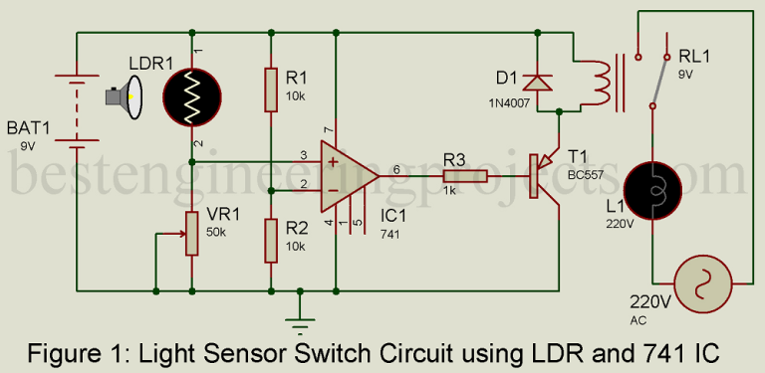
CIRCUIT DESCRIPTION
For description, we had divided the entire circuit into three main sections
Sensor unit
Voltage comparator unit
Switching circuit unit

Slide 5
SENSOR UNIT
The sensor is designed around an LDR and a variable resistor. We had used here GL5528 LDR photoresistor, but you can use any module as per the availability.
LDR is made from cadmium sulfide containing no or very few free electrons when not illuminated then its resistance is quite high. When it absorbed light, the electron is liberated and the conductivity of the material increases thus its resistance becomes low. The resistance rises to several Mega-ohm under dark.
LDR with variable resistance VR₁ forms a voltage divider network. The output of this network is given to non-inverting input as shown in figure 1. The LDR is a variable resistor whose resistance change according to the intensity of light falling on it. Variable resistor VR₁ is used to adjust the sensitivity of LDR i.e. on what intensity of light, the circuit triggers the load (Bulb).

Slide 6
VOLTAGE COMPARATOR UNIT
There is the various application of op-amp out of which IC 741 is configured in voltage comparator mode which compares input voltage levels given to two input pins (Inverting and non-inverting pins) and produces the output. Resistor R₁ and R₂ form a voltage divider network that divides Vcc into two parts thus ½ Vcc volt is available at inverting input.
Another input voltage is taken from the voltage divider network using LDR and a variable resistor (VR₁). Op-amp 741 compares these two voltage and produce output. If the voltage at pin 3 is high, the output of IC₁ is also high, and if volts at pin 3 the low output of IC₁ is low.

Slide 7
SWITCHING CIRCUIT UNIT
The switching circuit is designed using a general-purpose PNP transistor BC557. When the output of IC₁ is high, the transistor drives to the off state. As a result, Relay becomes dc-energized. When the output of IC741 is low, the transistor starts to conduct, and the relay becomes energized.

Slide 8
WORKING OF CIRCUIT
The LDR is a variable resistor whose resistance decreases with the increases in light intensity. When light falling on an LDR has low intensity (dependent upon adjustment of variable resistor VR₁), its resistor is large enough and the voltage across VR₁ is less than ½ V_{ref} thus output if IC₁ becomes low. This low output triggers the transistor T₁ and drives the Relay, as a result, the bulb start to glow.
However, when light falling on LDR is of large intensity, the resistance of LDR falls and the voltage drop across VR₁ is large enough (more than ½ Vcc). Thus, the output of IC₁ becomes high. This high output drives the transistor into off state and as a result, the relay becomes de-energized.

Slide 9
APPLICATIONS
Automatic Lighting Control: The circuit can be used to automatically control outdoor lights based on the ambient light level, saving energy during daylight hours.
Security Systems: It can be integrated into security systems to activate lights or alarms in response to changes in light conditions, indicating possible intrusions.
Energy Conservation: By automatically turning off lights in well-lit areas, the circuit helps conserve energy and reduce electricity bills.

Slide 10
CONCLUSION
The light sensor switch circuit using an LDR and a 741 IC is a versatile and cost-effective solution for various applications requiring automatic light control. With simple components and straightforward operation, it offers an efficient way to manage lighting based on ambient light levels.

